Slide 1
General Purpose I\O
(GPIO)
1
1
1
Copyright @ 2008 Real Time College
Copyright @ 2008 Real Time College

Slide 2
What is a GPIO?
37
General Purpose Input Output
A generic use pins on a chip whose behavior can be programmed at run time as:
Input to the chip.
Output to an external device.
Alternate function configuration.
Analog mode.

Slide 3
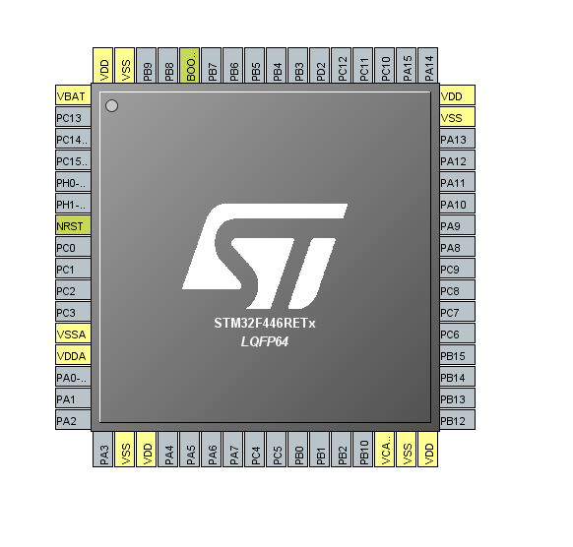
GPIO Configuration on Nucleo-F446RE
Nucleo-F446RE has 50 multi-functional/input/output pins and there are 4 ports as shown below:
— Port A(GPA): 10 -output pins port
— Port B(GPB): 11-input/output pins port
— Port C(GPC): 16-input/output pins port
3
3
3
Copyright @ 2008 Real Time College
Copyright @ 2008 Real Time College

Slide 4
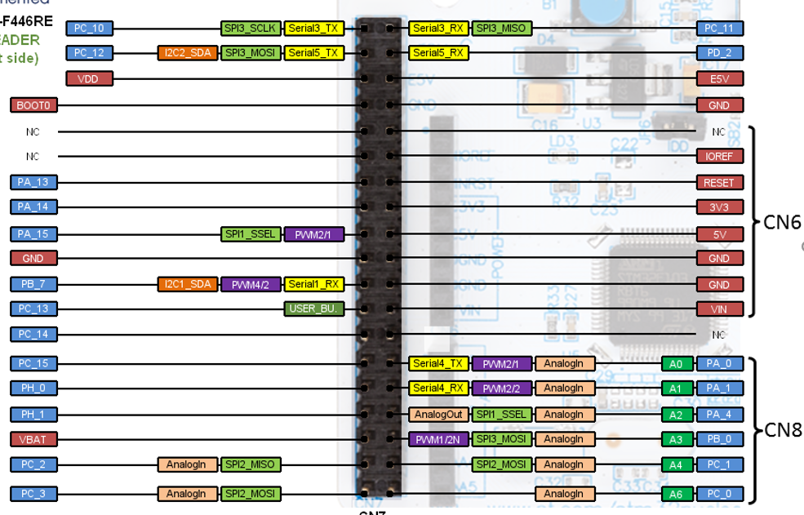
GPIO external pins on Nucleo-F446RE
Each GPI/O pin can be assessed using the Morpho extension pin headers as shown on a image below
Left side:

Slide 5
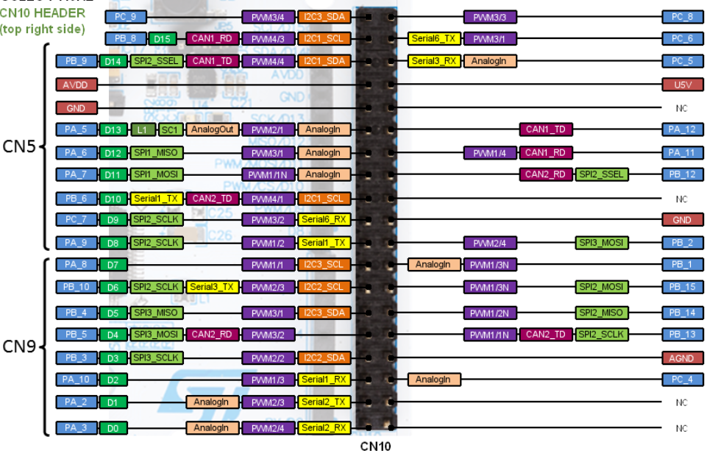
Each GPI/O pin can be assessed using the Morpho extension pin headers as shown on a image below
Right side:

Slide 6
GPI/O pins modes
Each GPI/O Pin can be configure to work in following modes:
1. Output mode:
GPIO output mode with push pull state
GPIO output mode with open drain state
2. Input mode:
GPIO input mode with high impedance (floating) mode
GPIO input mode with pull-up mode
GPIO input mode with pull-down mode
3. Alternate functionality mode
4. Analog mode

Slide 7
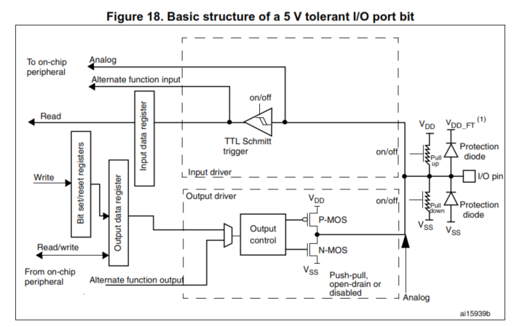
GPI/O peripheral diagram

Slide 8
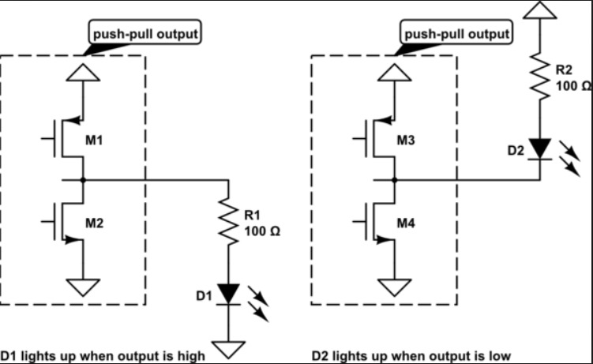
1. Output mode: GPIO output mode with push pull state
In this mode by writing Low or High to corresponding Port register we can control the output of the pin.

Slide 9
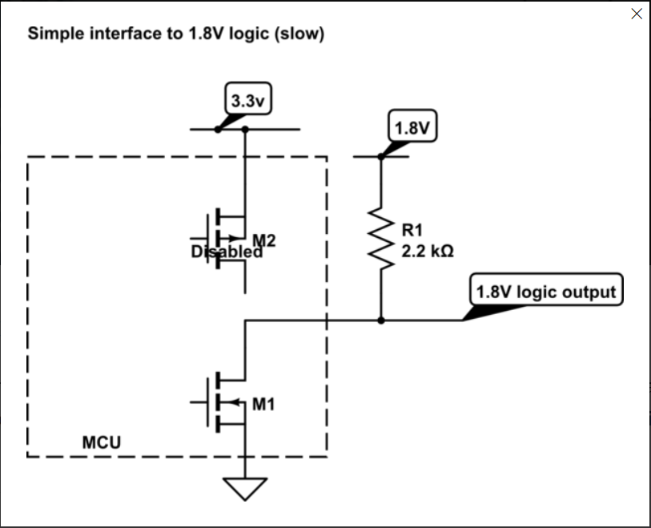
1. Output mode: GPIO output mode with open drain state
In this mode only pull down transistor activated and the pull up resistor connected.
We can control the output by turning on and off the transistor.

Slide 10
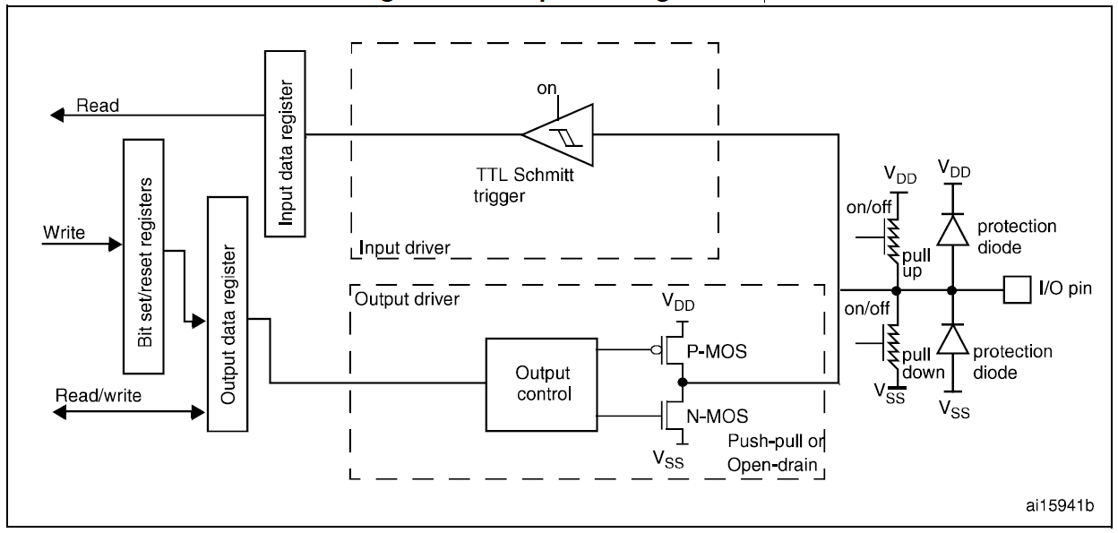
Output configuration

Slide 11
2. Input mode: GPIO input mode with high impedance (floating) mode
In GPI/O input mode we can read the value of the Pin using the corresponding Port register.
When GPIO pin is in input mode and not connected to a VCC or Ground the current leakage and the input value undefined
To prevent pin floating state pull up or pull down resistor must be connected to a pin in this mode,

Slide 12
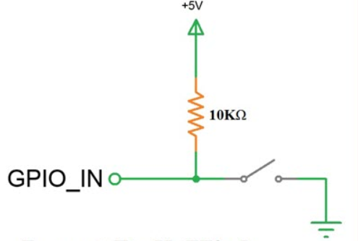
2. Input mode: GPIO input mode with pull-up resistor
After enabling the pull-up resistor, the input pin will be pulled up and normally high.
After closing the switch all current will flow to the ground and the input will change to low.

Slide 13
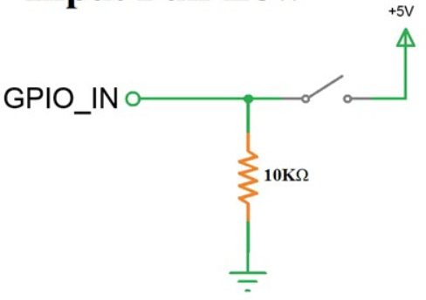
2. Input mode: GPIO input mode with pull-down resistor
After enabling the pull-down resistor, the input pin will be pulled down and normally low.
After closing the switch all current will flow to the pin and the input will change to high.

Slide 14
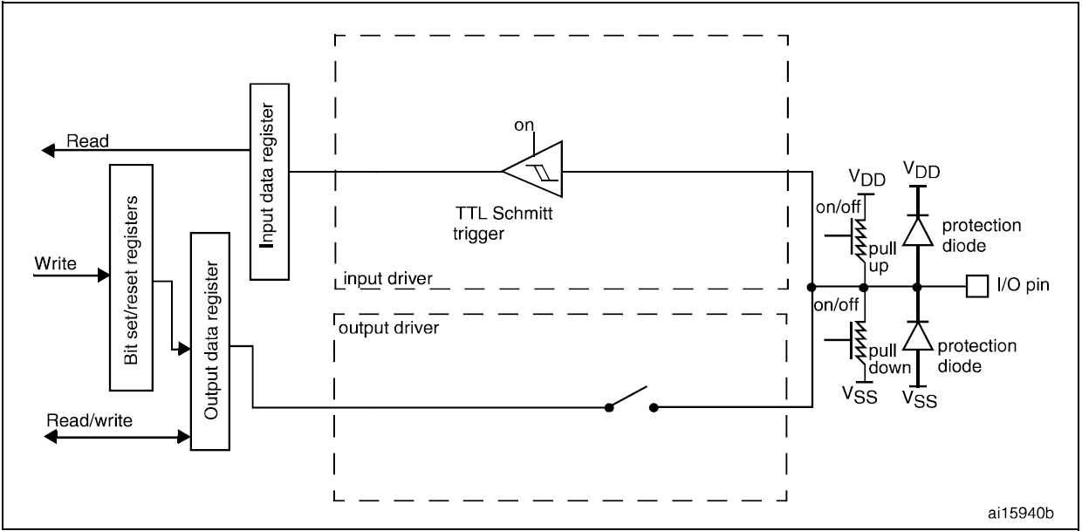
Input floating/pull up/pull down configurations

Slide 15
3. Alternate functionality mode
In alternate function the GPIO pin will be controlled by other peripheral(uart,i2c,can…).
We need to select which peripheral will be connected in alternate register.

Slide 16
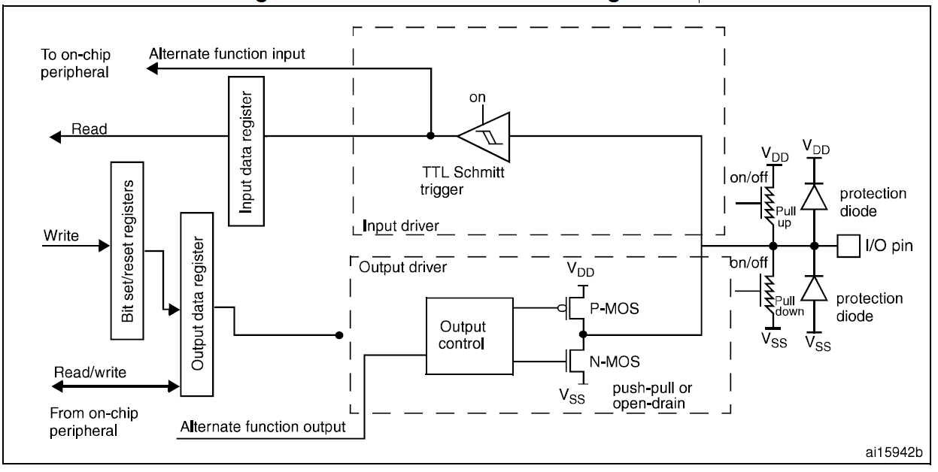
Alternate function configuration

Slide 17
4. Analog mode
Analog mode used to receive and transmit analog signal thought the GPIO pin.
To enable the Analog mode we need to configure special register.

Slide 18
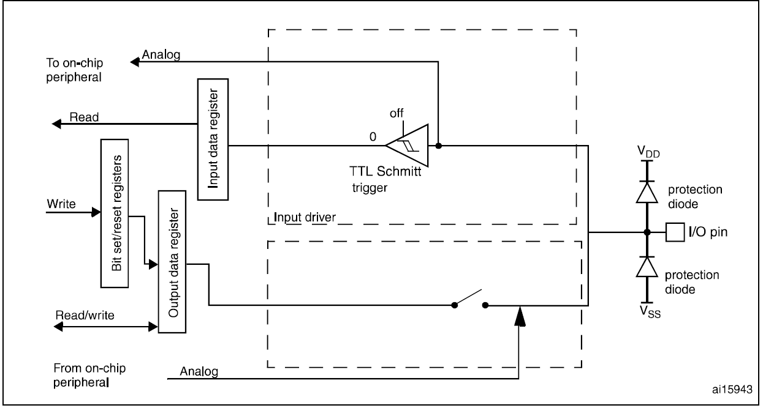
Analog configuration

Slide 19
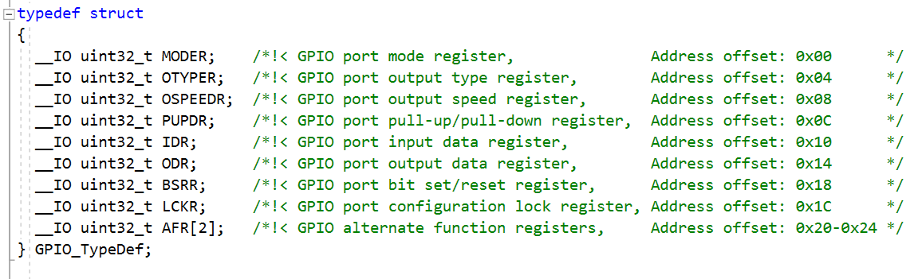
CMSIS GPIO STRUCT DEFENITION

Slide 20
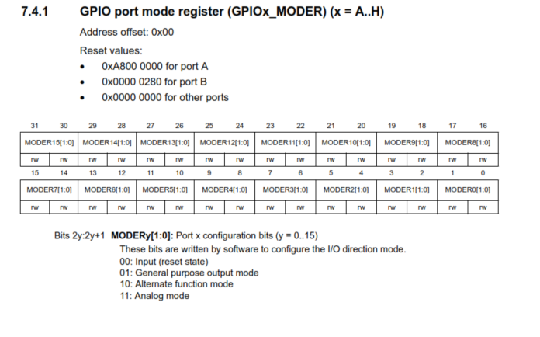
GPI/O Port configuration registers

Slide 21
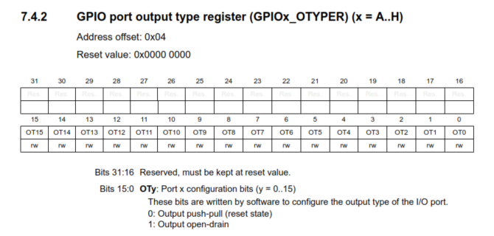
GPI/O Port configuration registers

Slide 22
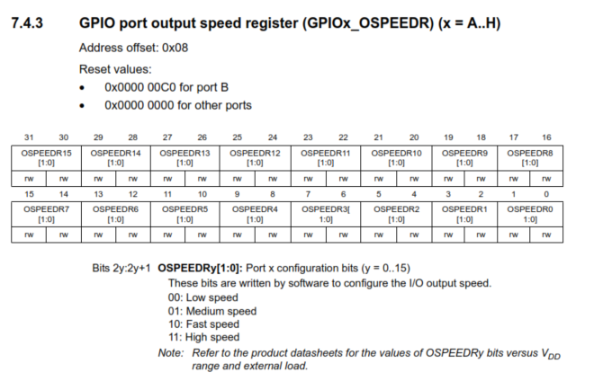
GPI/O Port configuration registers

Slide 23
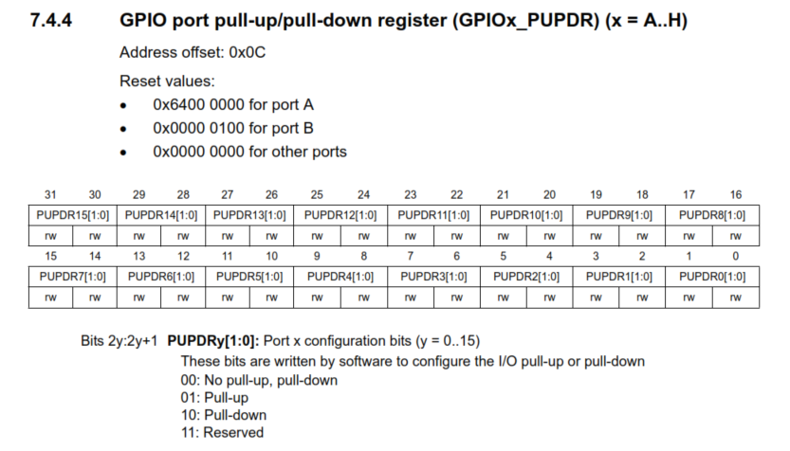
GPI/O Port configuration registers

Slide 24
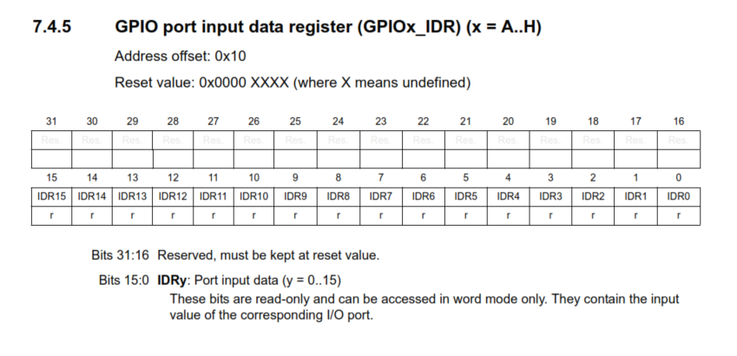
GPI/O Port configuration registers

Slide 25
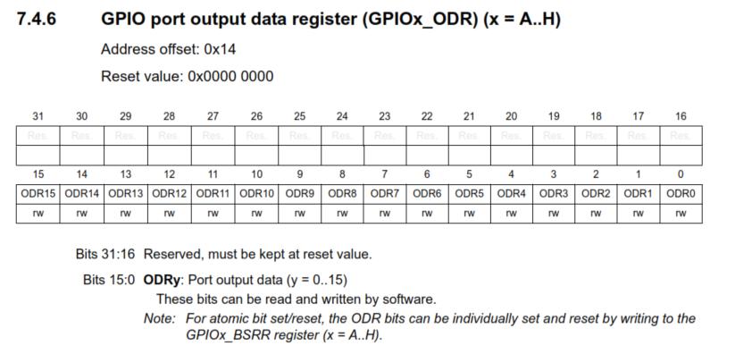
GPI/O Port configuration registers

Slide 26
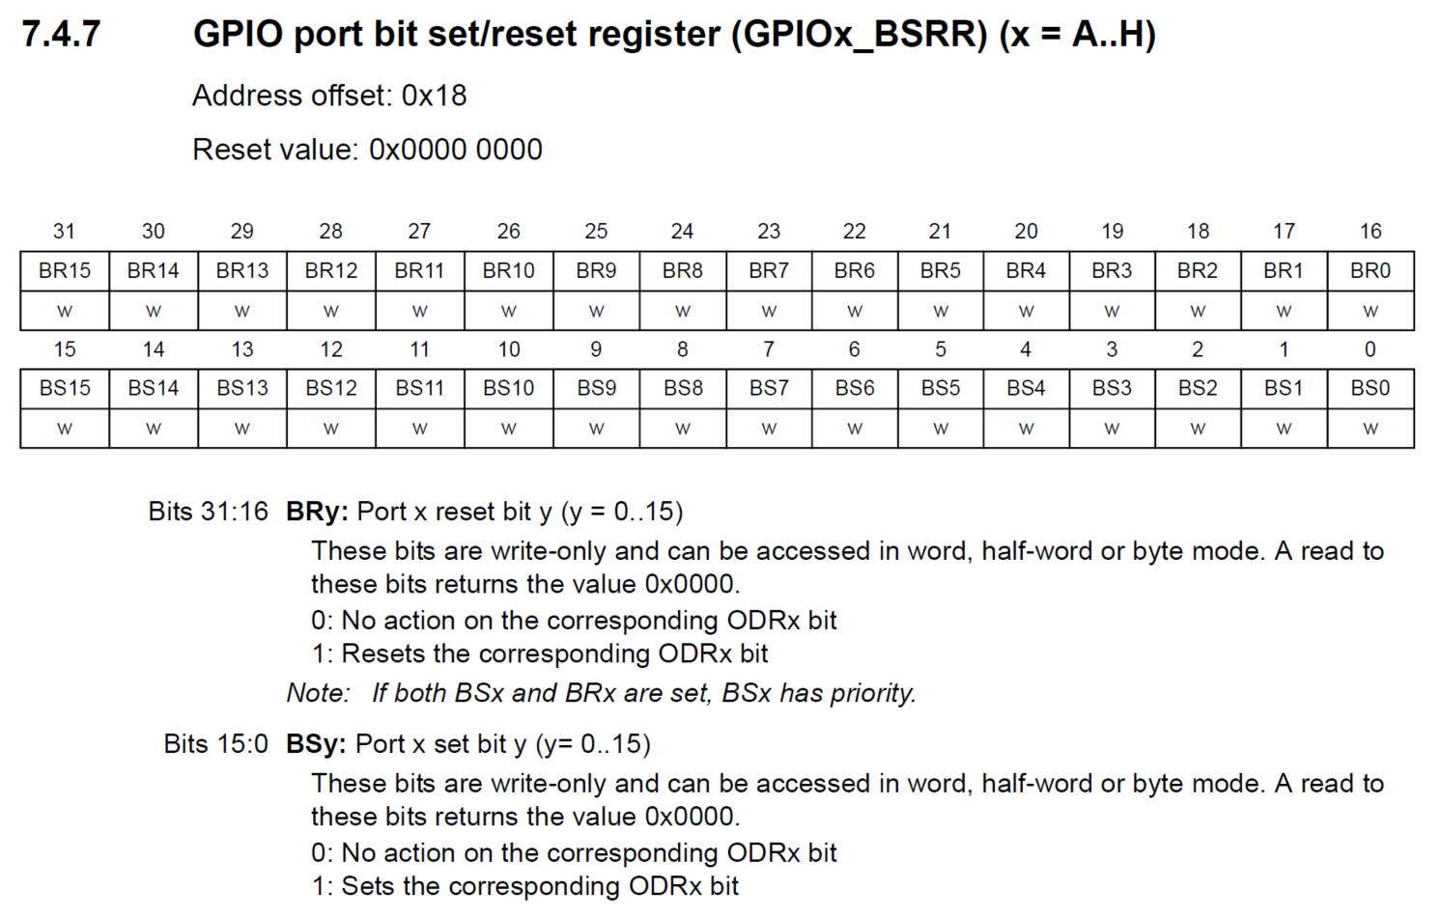
GPI/O Port configuration registers

Slide 27
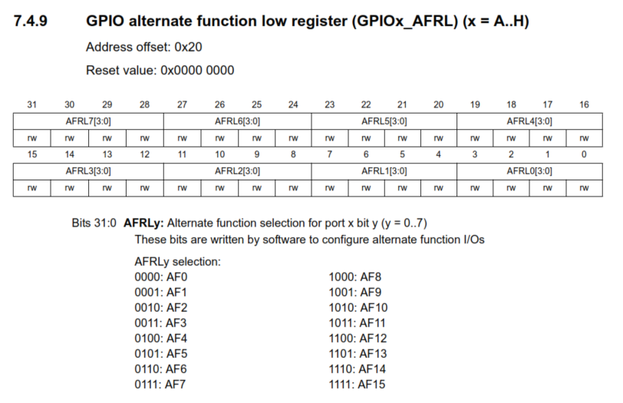
GPI/O Port configuration registers

Slide 28
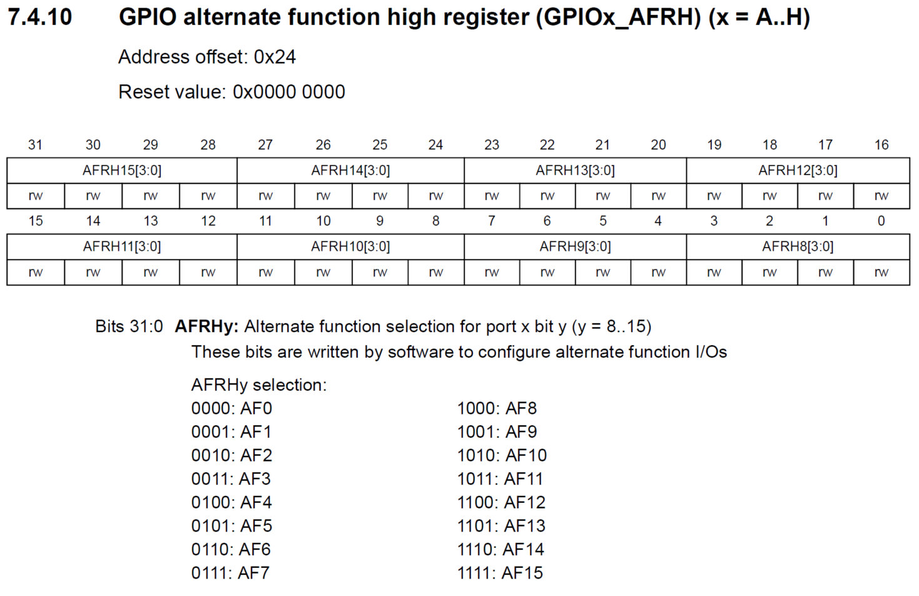
GPI/O Port configuration registers

Slide 29
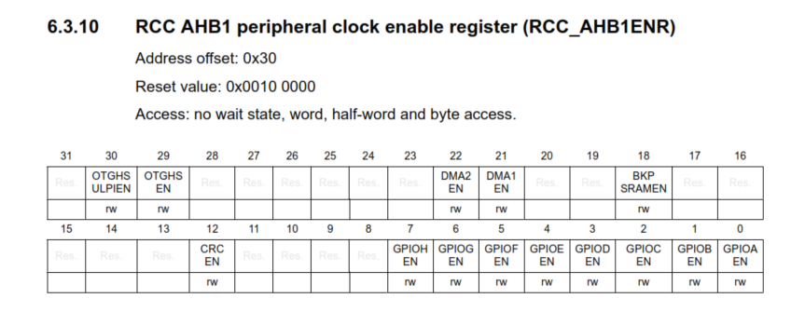
Peripheral clock register

Slide 30
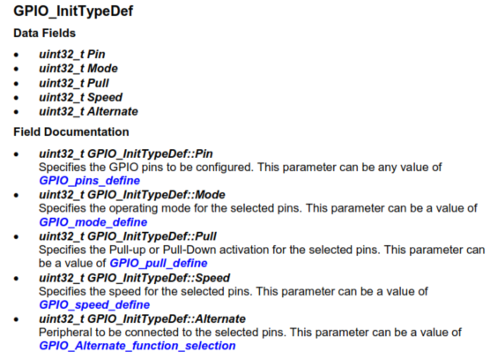
Functions GPIO Initialize

Slide 31
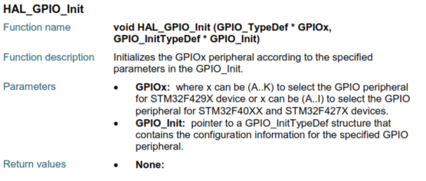
Functions

Slide 32
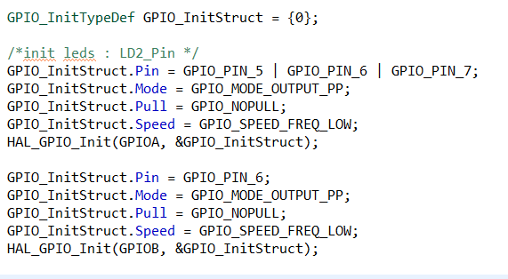
Functions

Slide 33
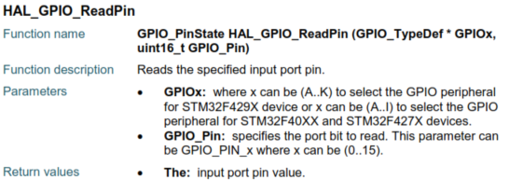

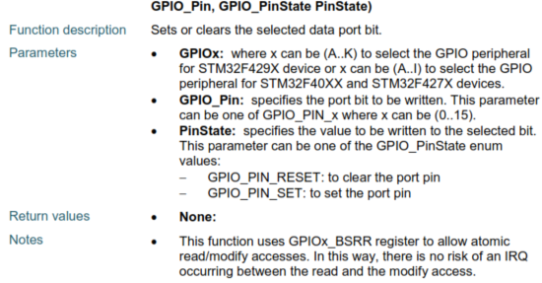
Functions GPIO pin set/reset

Slide 34
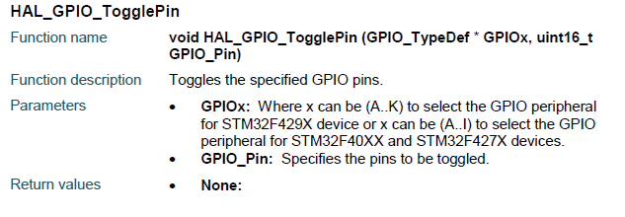
Functions

Slide 35
Functions

Slide 36
Class/Home work
Find the corresponding port and pin number of the onboard user led and onboard button.
Initialize the GPIO led pin to output mode and turn on the led using:
Direct registers access.
CMSIS.
HAL functions.
Perform the steps above for the onboard button (Initialize to input mode, check if pull up/down installed on the board)
Turn on the led when button is pressed
and print button state.

Slide 37
Class/Home work continued
Using the HAL Functions:
Make the led blink when the button is pressed and print the led state.
Change the speed of the led blink each time the button is pressed and use the printf() command to print blinking speed of the led.

